Slide 1
Need of Data Preparation

Slide 2
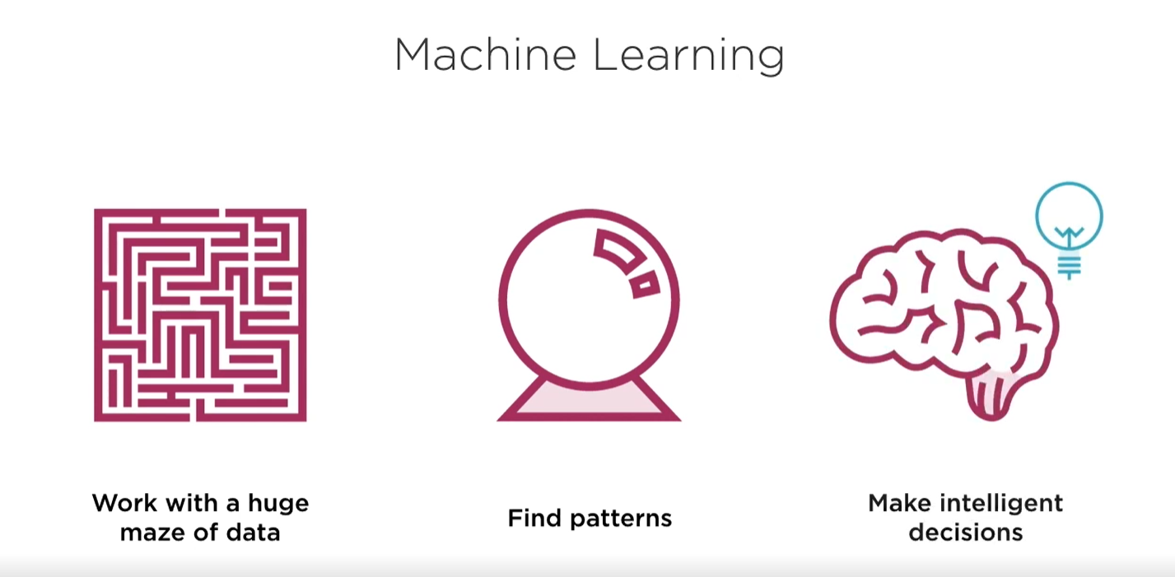
Machine Learning

Slide 3
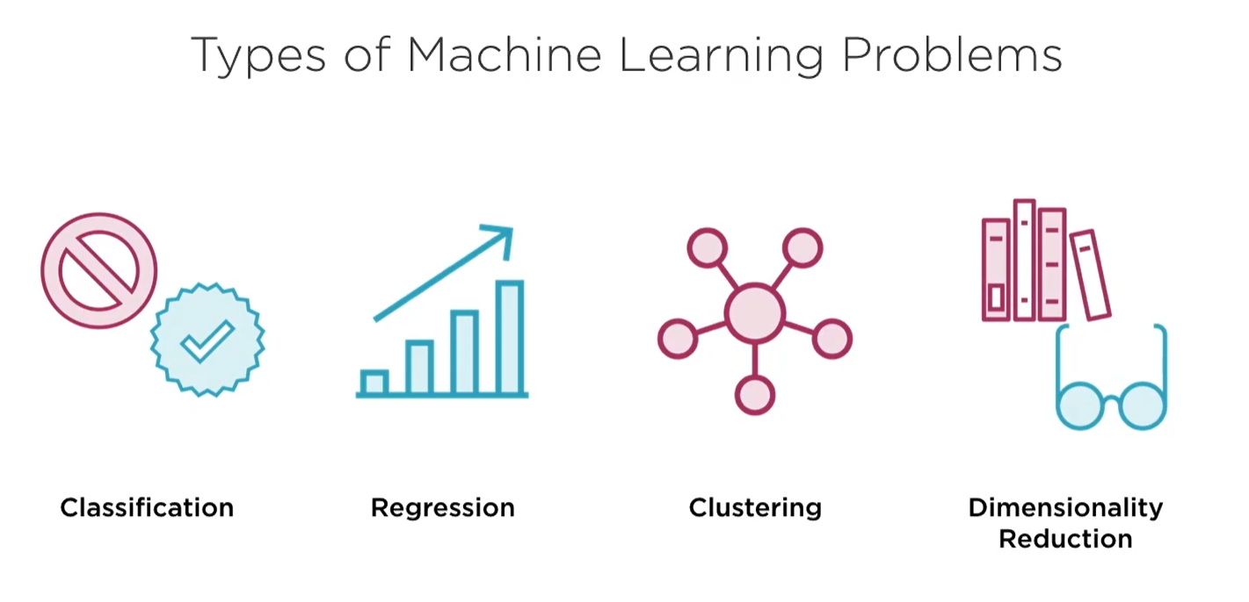
Applications of ML

Slide 4
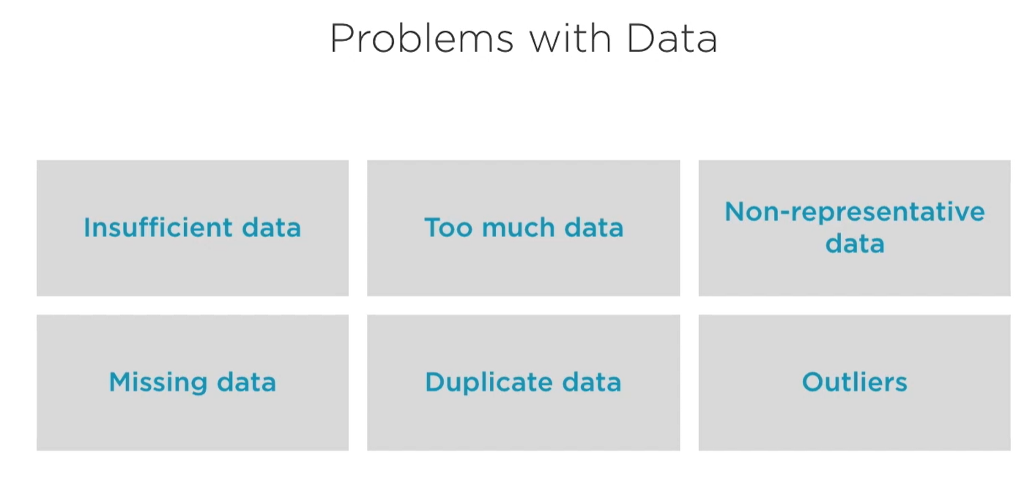
Problems with Data

Slide 5
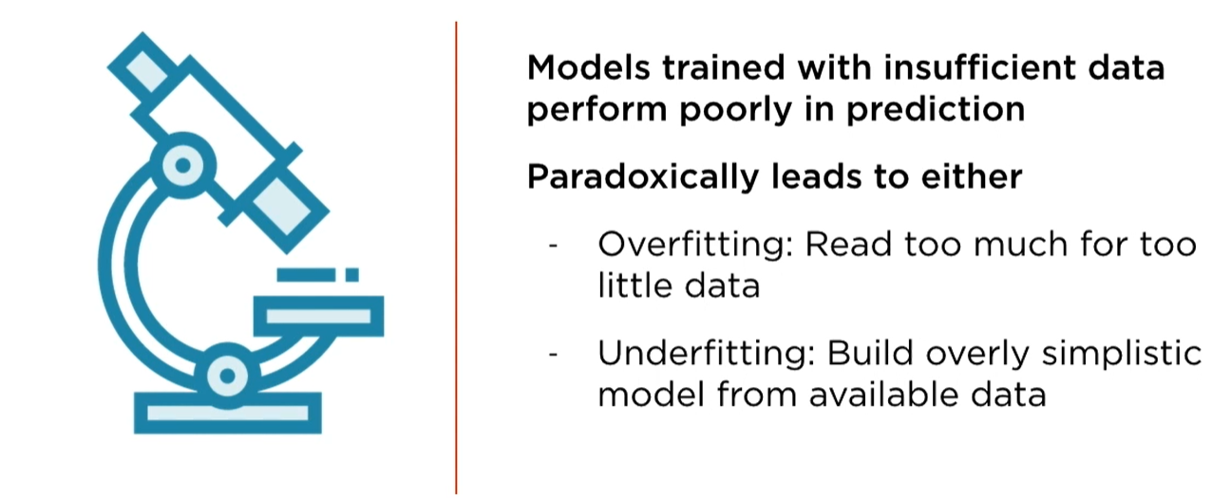
Insufficient Data

Slide 6
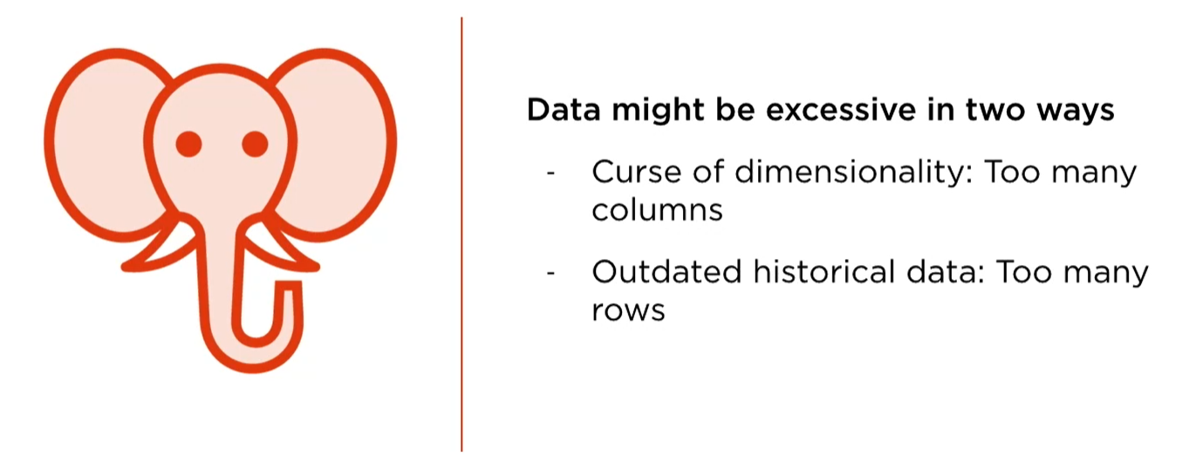
Too much Data

Slide 7
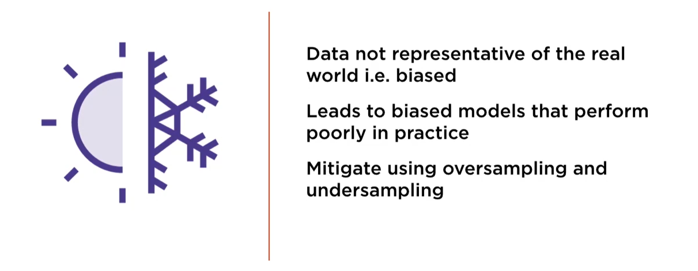
Non-Representative Data

Slide 8
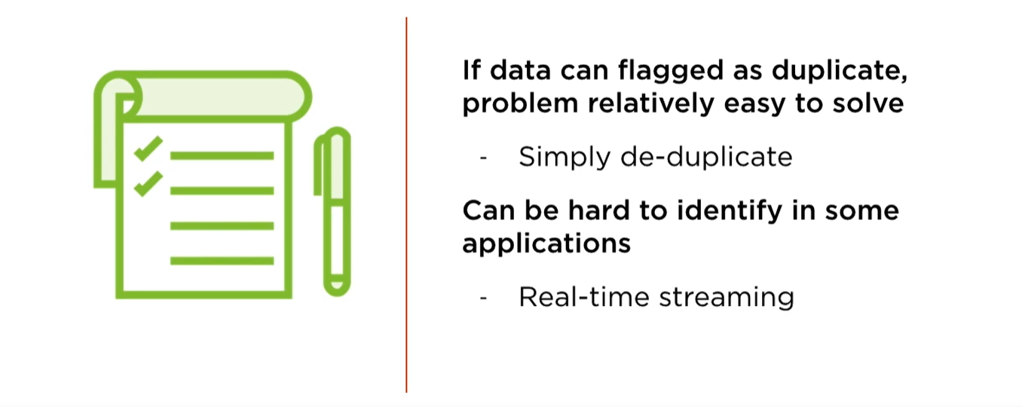
Duplicate Data

Slide 9
Missing Data
We can follow two ways for handling Missing Data
Deletion
Imputation

Slide 10
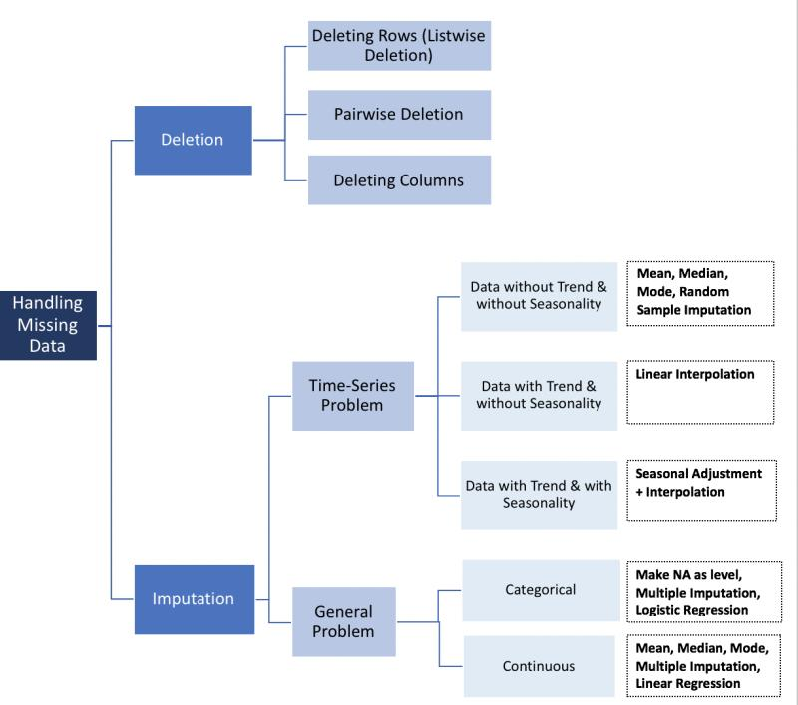

Slide 11
List-wise Deletion
Delete the entire row having a missing value in a column.
But it can lead to bias
Most common
If values are not missing randomly then it can introduce significant bias

Slide 12
Imputation
Fill in missing values instead of deletion with their mean or median or mode.
Can even build a model to predict missing values
Uni-variate Imputation: Rely only on the known values in a same feature
Multivariate Imputation: Predict value from all other known values using regression technique
Hot-deck Imputation: Sort the values using any criteria then for every missing value use immediately prior available value(a.k.a Last Observation Carried Forward)

Slide 13
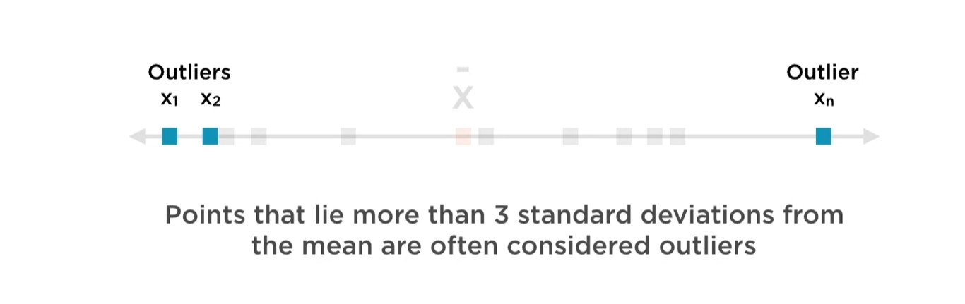
Outliers

Slide 14
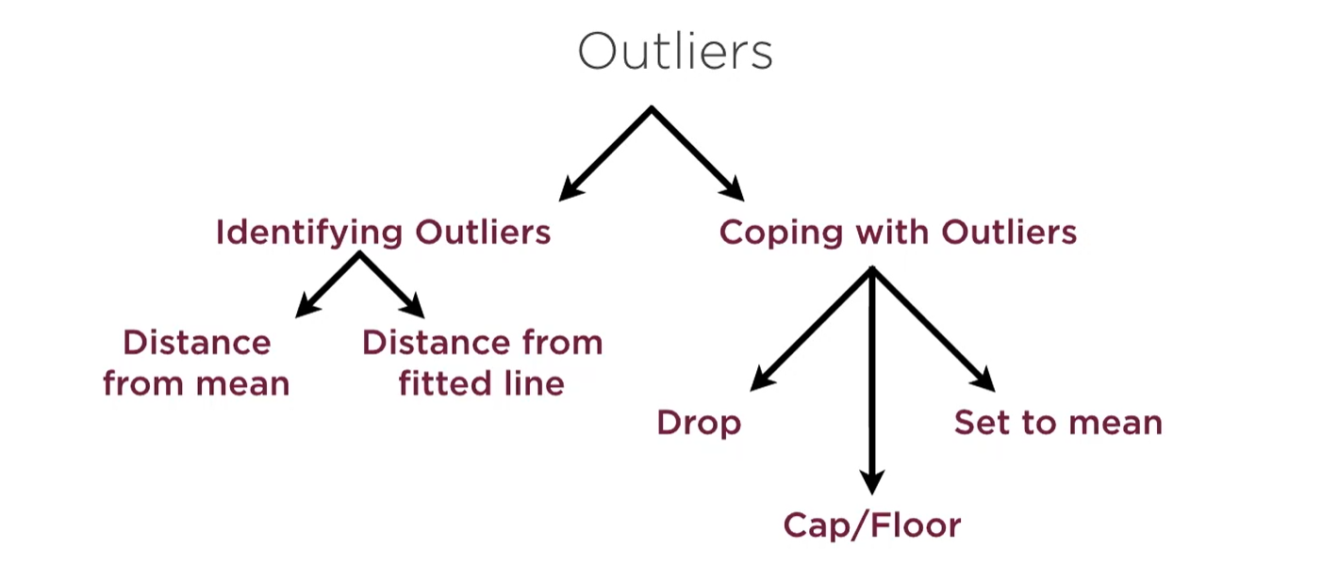
How to handle Outliers?

Slide 15
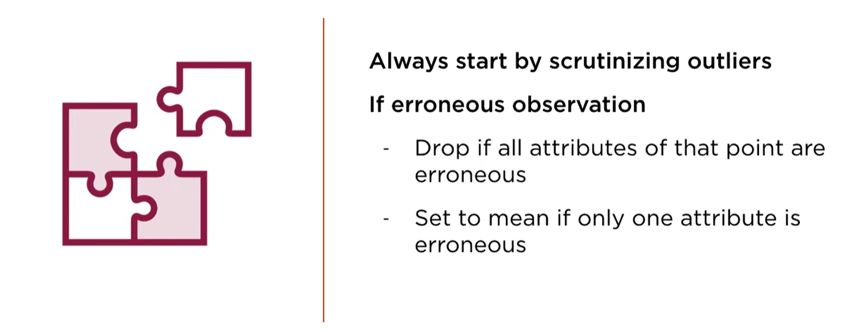
Points to remember while handling Outliers

Slide 16
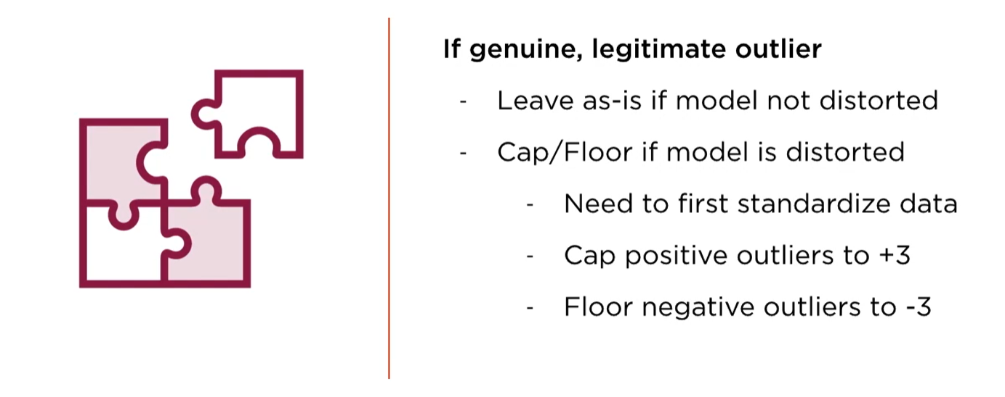
Points to remember while handling Outliers

Slide 17
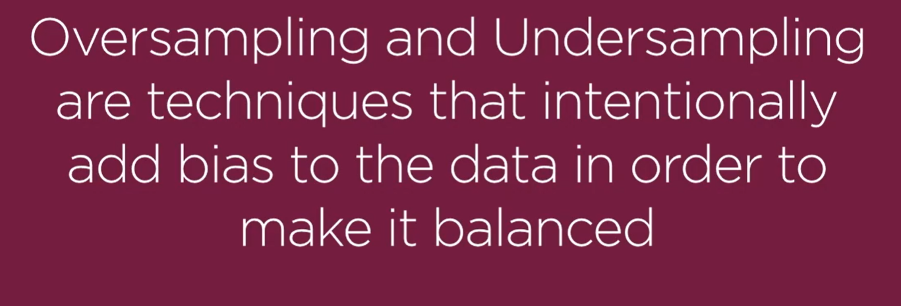
Oversampling & Under sampling

Slide 18
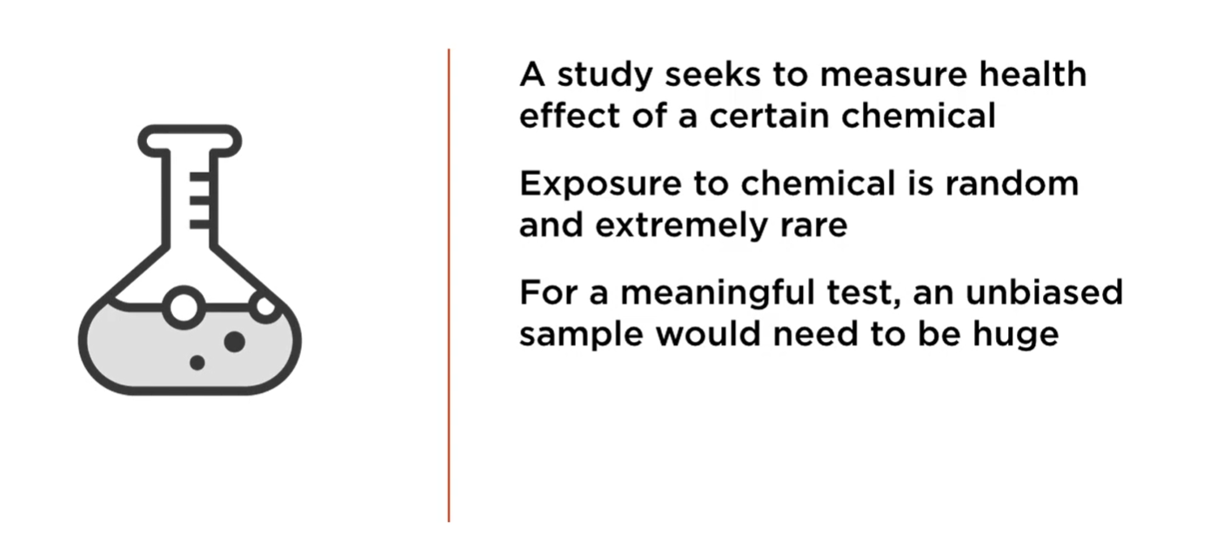
When Unbiased samples make it hard

Slide 19
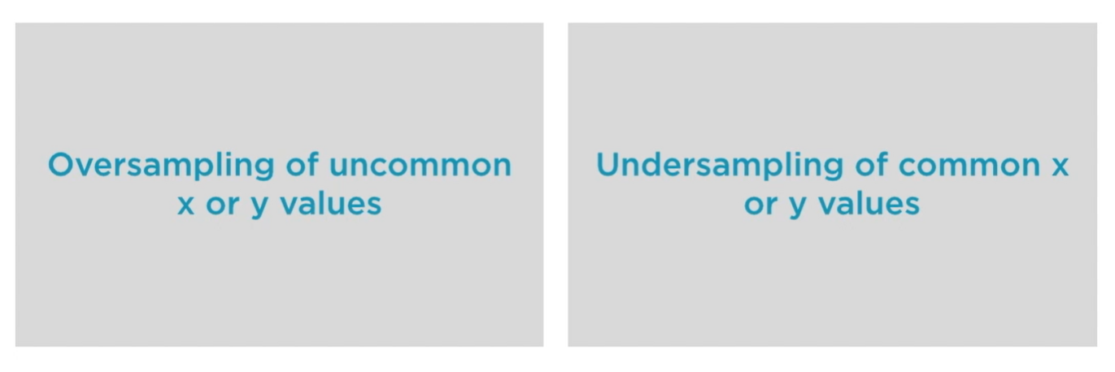
Balancing Datasets

Slide 20
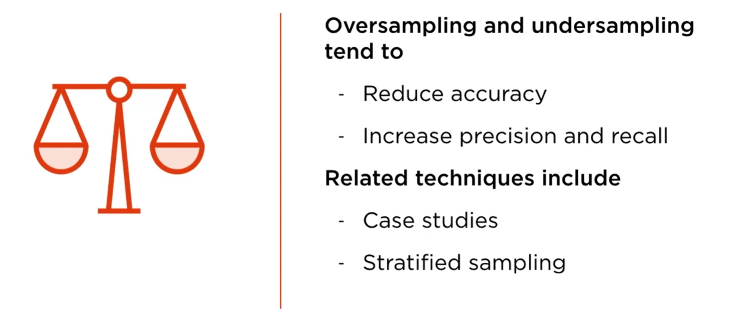
Forcibly balanced datasets

Slide 21
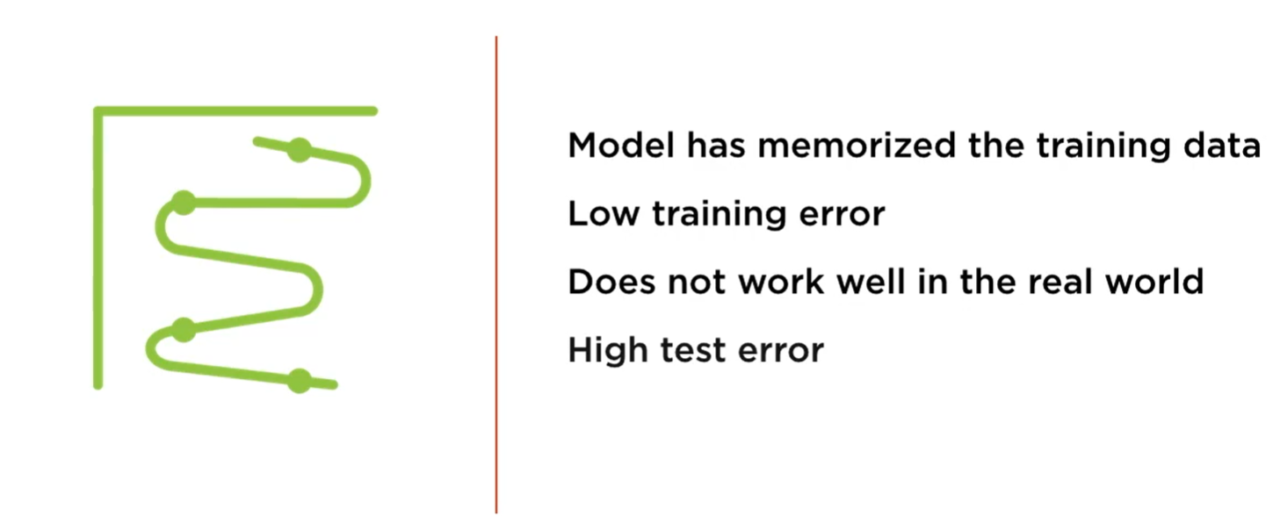
Overfitting

Slide 22
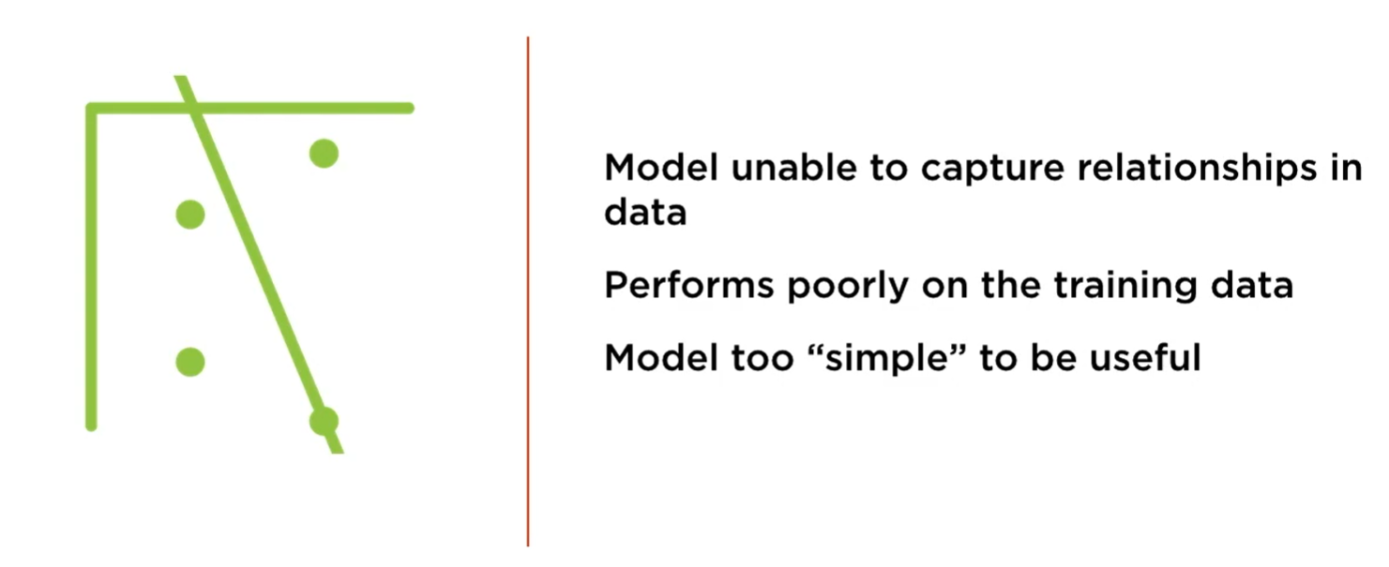
Under fitting

